Slide 1
Vietnam People
Vietnam Terms
Vietnam Legacy
Counterculture
Odds and Ends
10
10
10
10
10
20
20
20
20
20
30
30
30
30
30
40
40
40
40
40
50
50
50
50
50

Slide 2
Category 1 questions follow

Slide 3
Category 1
Who fought Japan, then, as the leader of North Vietnam, fought France and the United States?
10

Slide 4
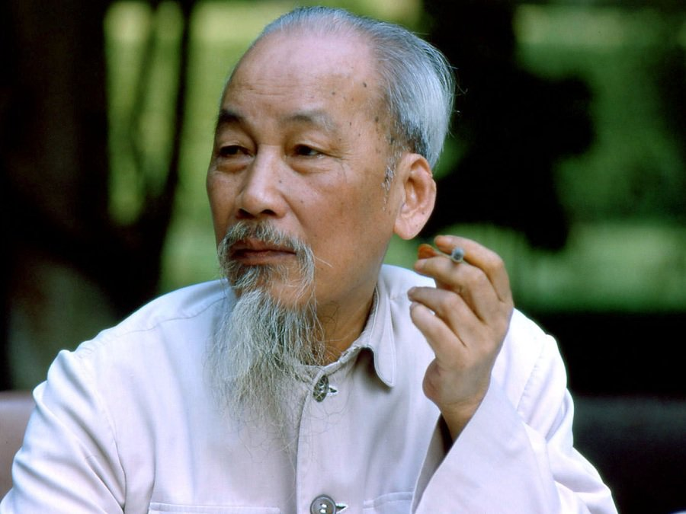
Category 1
Ho Chi Minh
10

Slide 5
Category 1
What anti-Communist leader of South Vietnam was assassinated in 1963?
20

Slide 6
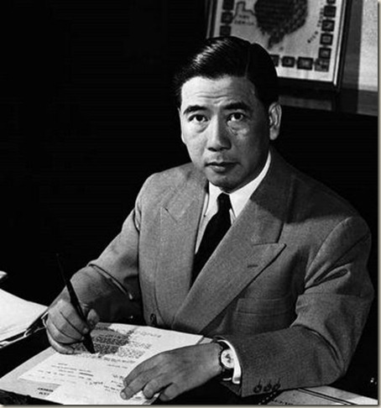
Category 1
Ngo Dinh Diem
20

Slide 7
Category 1
What U.S. president sent combat troops to Vietnam in 1964?
30

Slide 8
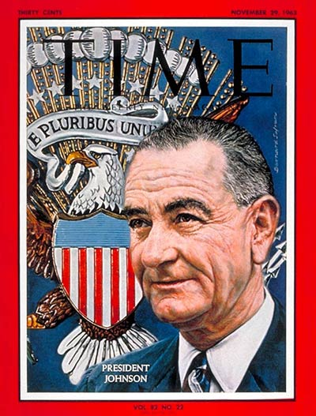
Category 1
Lyndon Johnson
30

Slide 9
Category 1
Who was the American commander in Vietnam?
40

Slide 10
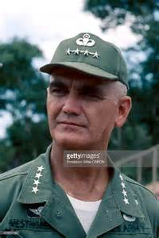
Category 1
General William Westmoreland
40

Slide 11
Category 1
What TV newscaster announced in 1968 that it seemed “more certain than ever that the bloody experience in Vietnam is to end in a stalemate?”
50

Slide 12
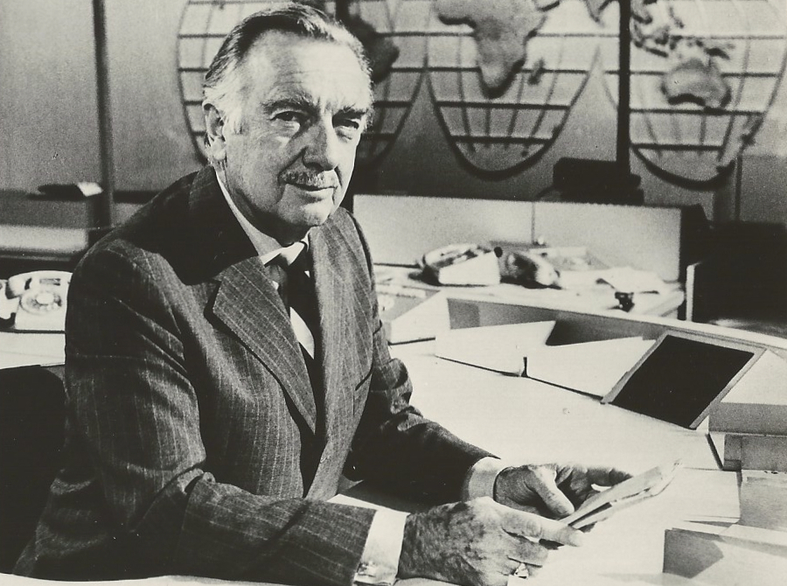
Category 1
Walter Cronkite
50

Slide 13
Category 2 questions follow

Slide 14
Category 2
The French left Vietnam after loosing the battle of _____________.
10

Slide 15
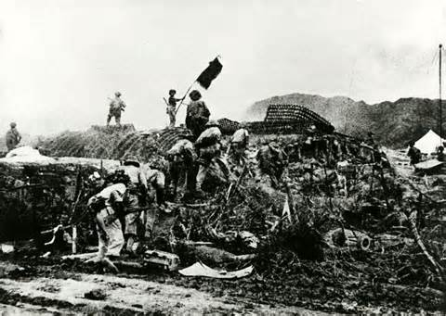
Category 2
Dien Bien Phu.
10

Slide 16
What guerilla army of South Vietnamese communists was organized by the North Vietnamese government?
20

Slide 17
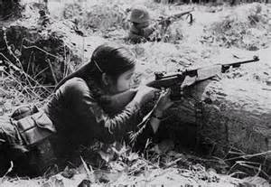
Category 2
The Vietcong
20

Slide 18
Category 2
What 1964 congressional legislation allowed President Johnson to go to war in Vietnam?
30

Slide 19
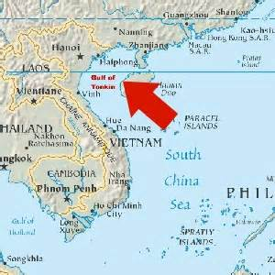
Category 2
The Gulf of Tonkin Resolution
30

Slide 20
Category 2
As Americans increasingly doubted Johnson’s assurances of eventual victory in Vietnam, a _____________ developed.
40

Slide 21
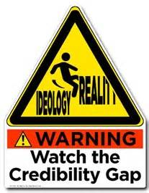
Category 2
credibility gap
40

Slide 22
Category 2
In this 1968 surprise attack, guerilla fighters staged attacks in cities and airbases of the South and blasted into the American embassy in Saigon.
50

Slide 23
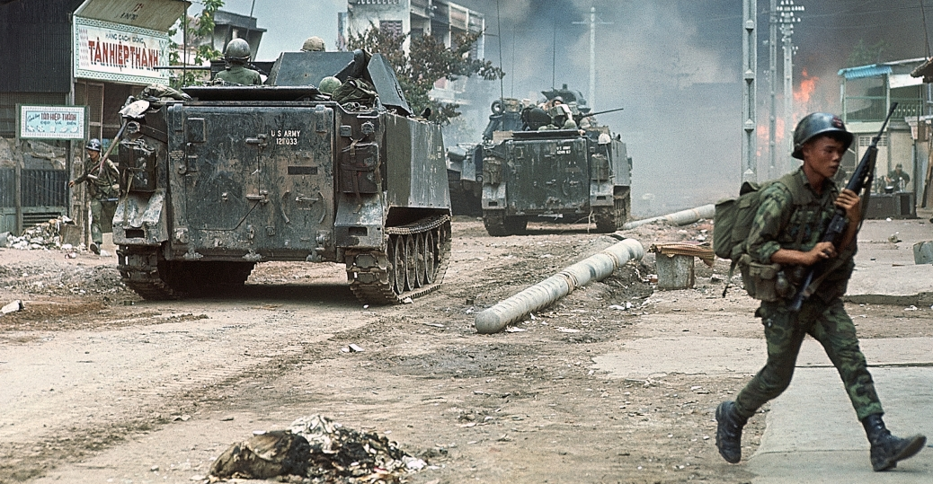
Category 2
The Tet Offensive
50

Slide 24
Category 3 questions follow

Slide 25
Category 3
This national security advisor worked to improve relations with the Soviet Union and China in order to persuade them to cut back on aid to North Vietnam.
10

Slide 26
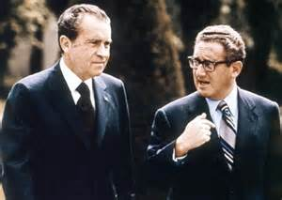
Category 3
Henry Kissenger
10

Slide 27
Category 3
A massacre at this South Vietnamese village became a symbol of the senselessness of the war for many Americans.
20

Slide 28
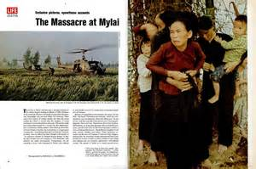
Category 3
My Lai
20

Slide 29
Category 3
After President Nixon invaded Cambodia, a student protest at this college resulted in the deaths of four demonstrators.
30

Slide 30
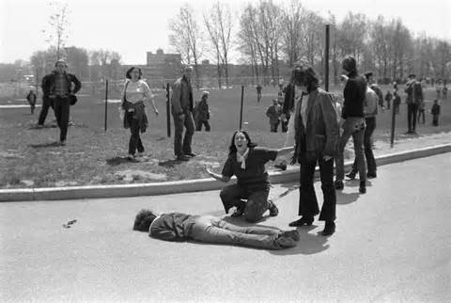
Category 3
Kent State University
30

Slide 31
Category 3
Daniel Ellsberg leaked these documents to show that the many in the Johnson administration had privately questioned the war while publicly defending it.
40

Slide 32
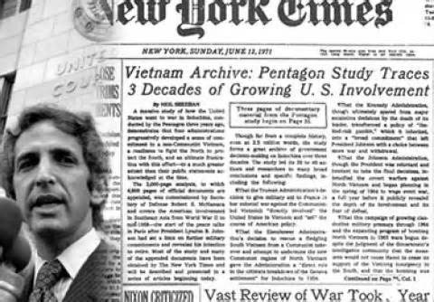
Category 3
The Pentagon Papers
40

Slide 33
Category 3
What legislation did Congress pas in 1973 to reestablish limits on power of presidents to go to war?
50

Slide 34
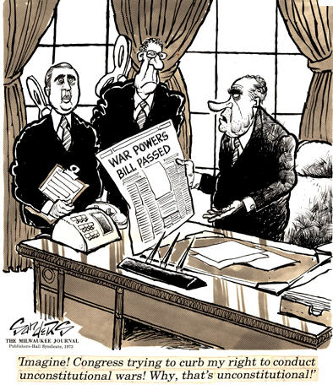
Category 3
The War Powers Act
50

Slide 35
Category 4 questions follow

Slide 36
Category 4
What movement began at the University of California at Berkeley in 1964, led by students who wanted to exercise their First Amendment rights?
10

Slide 37
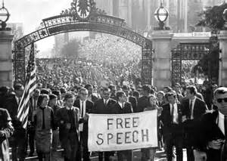
Category 4
The Free Speech Movement
10

Slide 38
Category 4
What folk musician turned voice of the counterculture will receive the 2016 Nobel Prize for Literature?
20

Slide 39
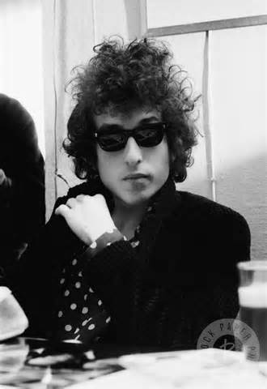
Category 4
Bob Dylan
20

Slide 40
Category 4
A popular hippie destination in 1967 San Francisco was _____________________.
30

Slide 41
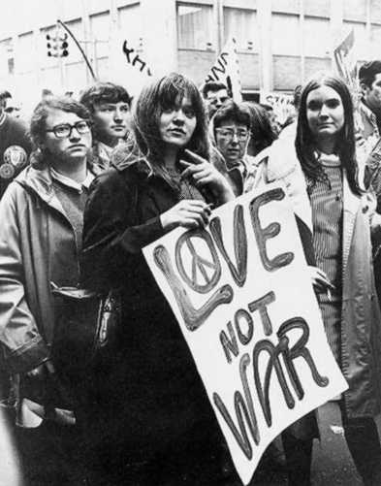
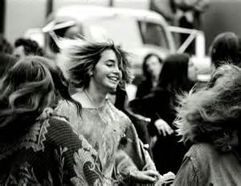
Category 4
Haight-Ashbury
30

Slide 42
Category 4
What music festival was held in August 1969 in upstate New York, drawing hundreds of thousands of young people?
40

Slide 43
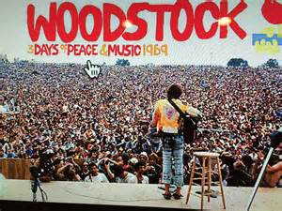
Category 4
Woodstock
40

Slide 44
Category 4
Complete the following lyric:
“There’s a battle outside And it’s ragin’. It’ll soon shake your windows And rattle your walls . . .
50

Slide 45
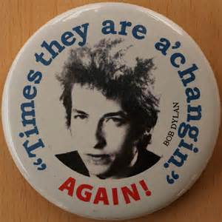
Category 4
For the times they are-a-changin’.”
50

Slide 46
Category 5 questions follow

Slide 47
Category 5
Betty Friedan and other feminists formed this organization to promote their goals.
10

Slide 48
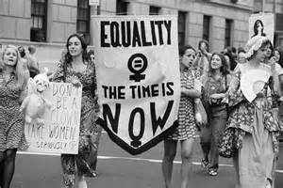
Category 5
The National Organization
for Women
10

Slide 49
Category 5
What proposed amendment, passed by Congress in 1972, was never ratified by enough states to become law?
20

Slide 50
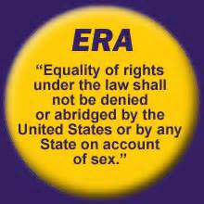
Category 5
The Equal Rights Amendment (ERA)
20

Slide 51
Category 5
What two terms were used to identify Americans who supported and were against the war in Vietnam?
30

Slide 52
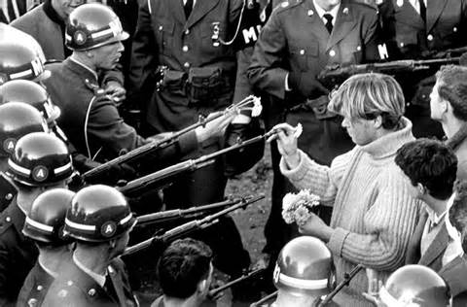
Category 5
hawks and doves
30

Slide 53
Category 5
What jellied gasoline was dropped by American planes over Vietnam, exploding on contact?
40

Slide 54
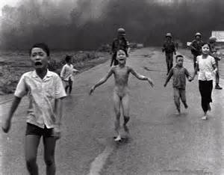
Category 5
napalm
40

Slide 55
Category 5
In what year was Vietnam unified under Communist rule?
50

Slide 56
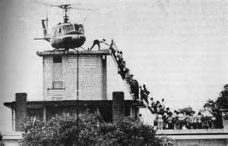
Category 5
1975
50

